Slide 1
Estonian Jews and their contribution to the creation and development of the state of Israel

Slide 2
Jews in Estonia
1333 – first written mentioning of a Jew in Estonia
Occasional Jewish traders, doctors and craftsmen, but no permanent community
From 1721 – Estonia becomes part of the Russian empire. Big increase in the number of Jews after division of Poland in 1772. Jews are periodically expelled from Russia.
1791 – the Pale of settlement. Estonia is not in the Pale, thus the number of Jews in Estonia is restricted.
1840 – Nicolai soldiers, high level Jewish craftsmen, high school graduates etc. get permission to settle anywhere in Russia. This brings to establishing of Jewish communities in the major Estonian cities.

Slide 3
The number of Jews in Estonia
From 1881 till 1979 – ~0.4% from total population, 2012 - ~0.15%

Slide 4
Some famous Estonian Jews outside Estonia
Architects: Louis Kahn (Schmuilowsky)
Sculptors: Dora Gordin, Benno Schotz, Minna Harkawy (Rothenberg)
Musicians: Nikolai Lopatnikoff, Herman Biek (aka Ben Berlin)
Poets: Jehoshua Gabriel Preil
Filmmakers: Dimitri Kirsanoff (Kaplan)
Public figures: S. H. Shapiro – the Gov. of Illinois, Rabbi Zvi J. Epstein, M. Josselson – CIA, etc.

Slide 5
Two acceptable solutions to the so called
“Jewish problem”:
In the country of residence
Emancipation (1917)
and
Cultural autonomy (1926)

Slide 6
Two acceptable solutions to the so called
“Jewish problem”:
In the country of residence
In the homeland of Jewish people
Emancipation (1917)
and
Cultural autonomy (1926)
Zionism movement (1897)
and
The Jewish state (1948)

Slide 7
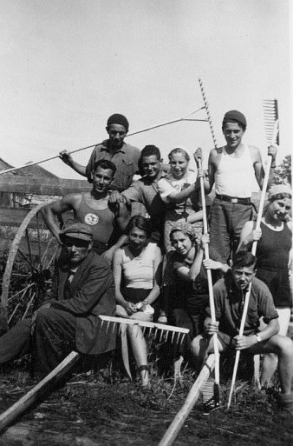
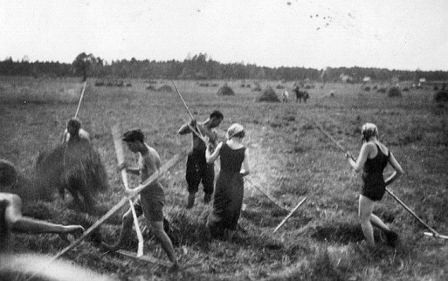
„Achshara“ (preparation [for agricultural work in Palestine])
In Sangaste in 1936
1929-1936 Kiltsi, Särevere, Matsalu, Sangaste,
Saaremaa, Kurna, Luunja and other places.

Slide 8
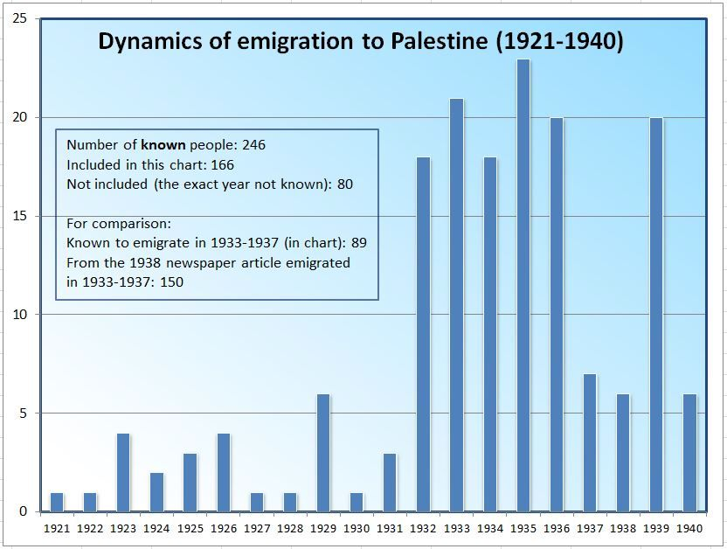

Slide 9
Postimees: „21 persons left Estonia for Palestine in 1932“
4 doctors
1 dentist
1 lawyer
1 agronomist
1 nurse
1 school teacher
12 field- and craftsmen

Slide 10
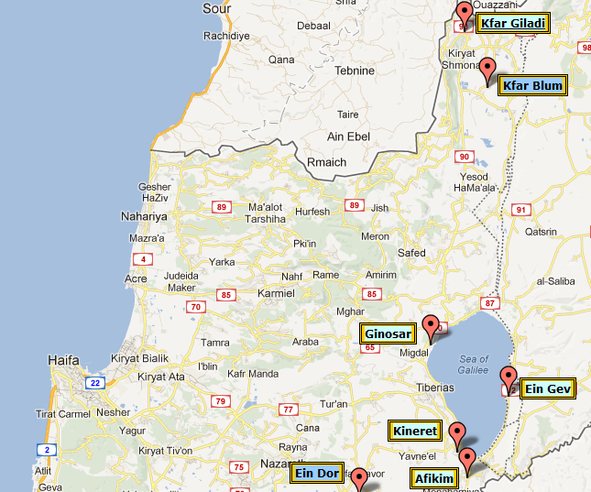
Among the founders of
9 kibbutzim were around
40 Estonian Jews

Slide 11
Among the founders of
9 kibbutzim were around
40 Estonian Jews
Based on “Inventing Our Lives: The Kibbutz
experience” (excerpt on Youtube)

Slide 12
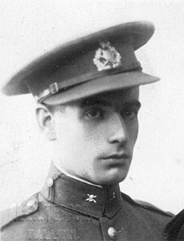
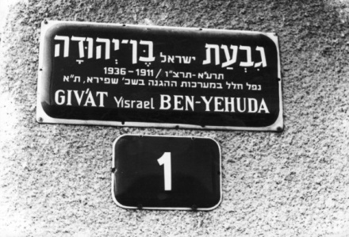
Fighting for a peaceful life in Palestine…
Israel Ben-Yehuda (Itzoch) was Hagana fighter.
Killed in Tel-Aviv in 1936 by a British soldier.
A street on his name in Tel-Aviv.
Israel Itzoch (b. 1911 in Narva)
in Estonian army (1932).

Slide 13
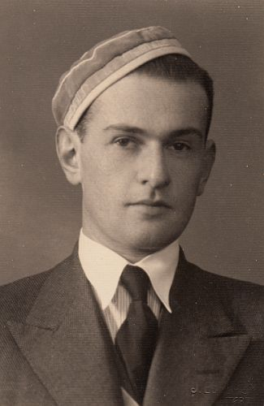
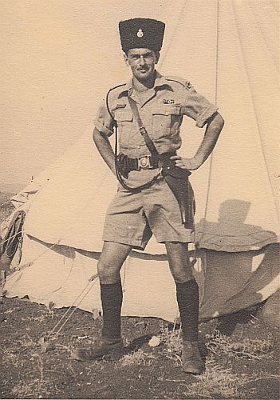
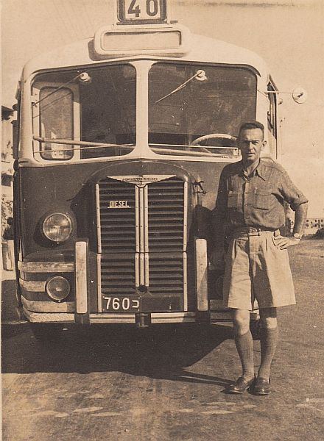
… a policeman and a bus driver
Aleksander Gini
(Ginizisky) 1911-1974
Tartu University
corporant (Hasmonea)
1934, …
As a member of British boarder
Police in 1936 …
„Egged“ bus driver
1939

Slide 14
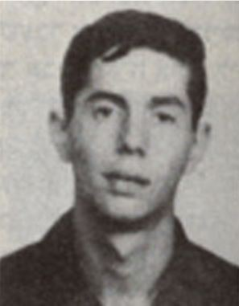
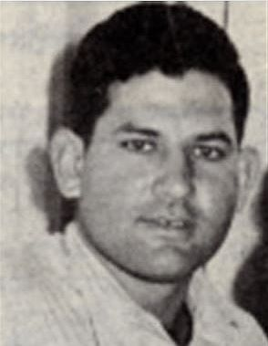
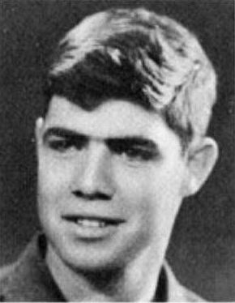
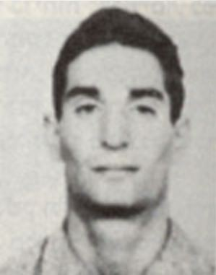
They fell defending the state of Israel
Ehud Gordon (1950-1973)
Gabriel Bakscht (1932-1956)
Alik Kligsberg (1943-1967)
Be blessed their memory – ז"ל

Slide 15
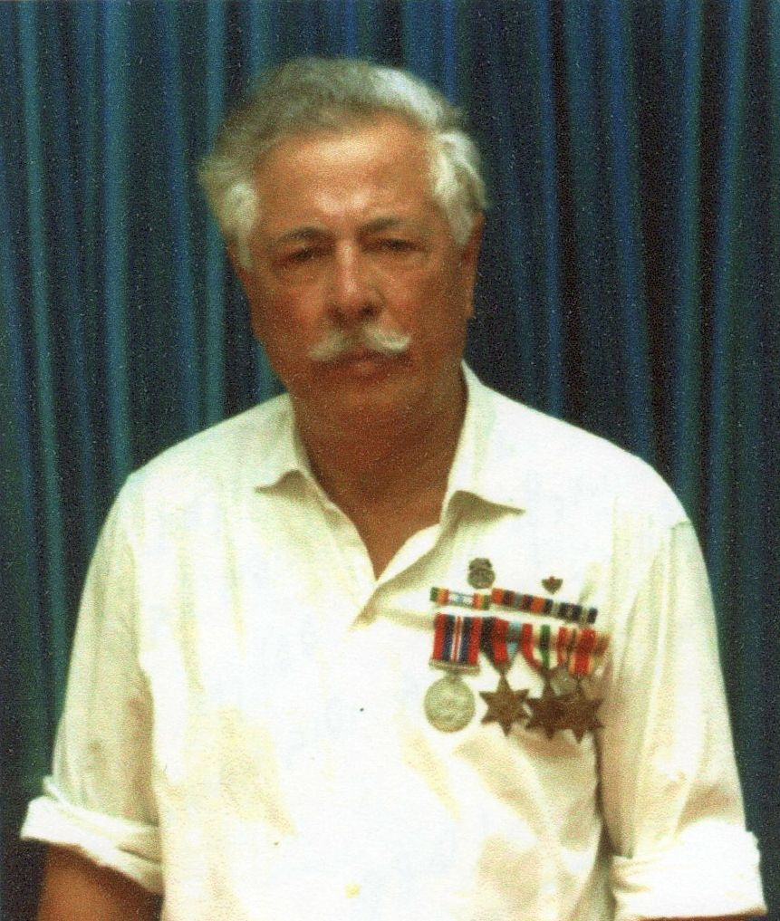
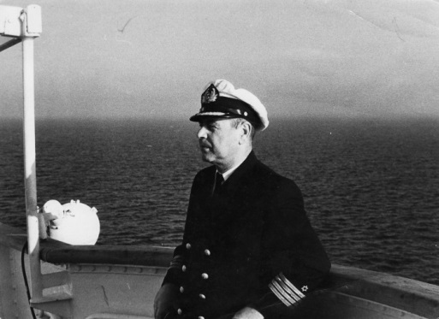
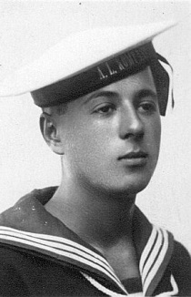
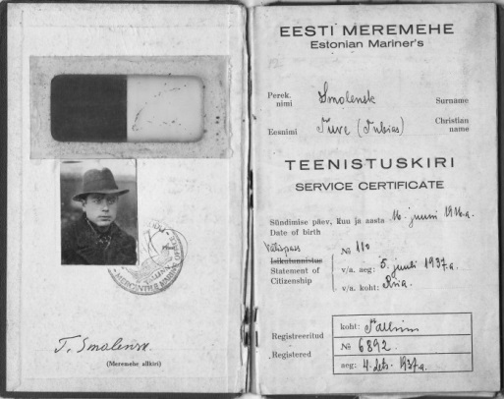
In Israel cargo and battle fleet
Asher Ben-Shmuel (Itzoch) (1913 – 1995)
Tuvja Smolensk (1916 – 1993)
Seaman of Estonian
ship „Kompass“
in 1933.
Estonian Mariner’s
Service certificate 1937.

Slide 16
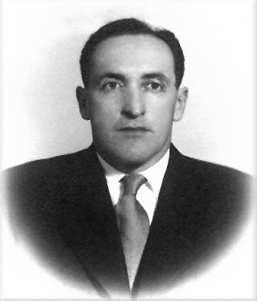
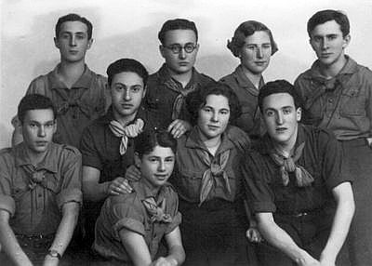
Statesmen…
Nechemia Levanon (Levitan)
(1915 Rūjiena, Latvia – 2003 Kfar Blum)
1933-1937 – founder of the Hashomer
Hazair (Nezach) movement in Estonia

Slide 17
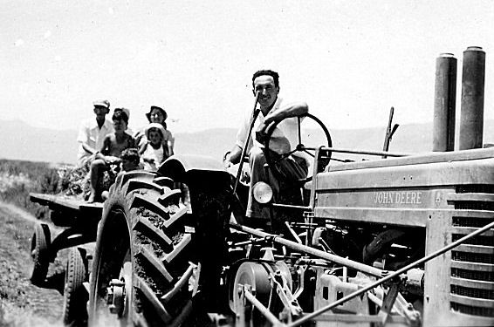
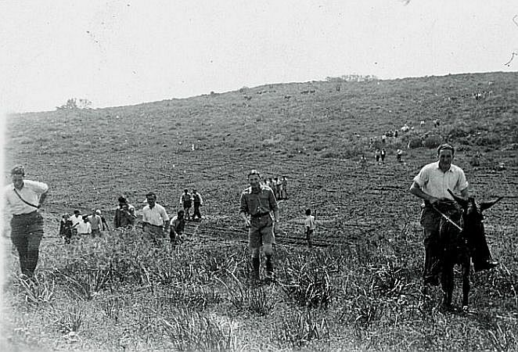
Statesmen…
1938 – Kibbutz „Anglo-Balti“
1943 – kibbutz Afikim founder
1948 – in the war of Independence
1948 - 1953 – kibbutz Afikim

Slide 18
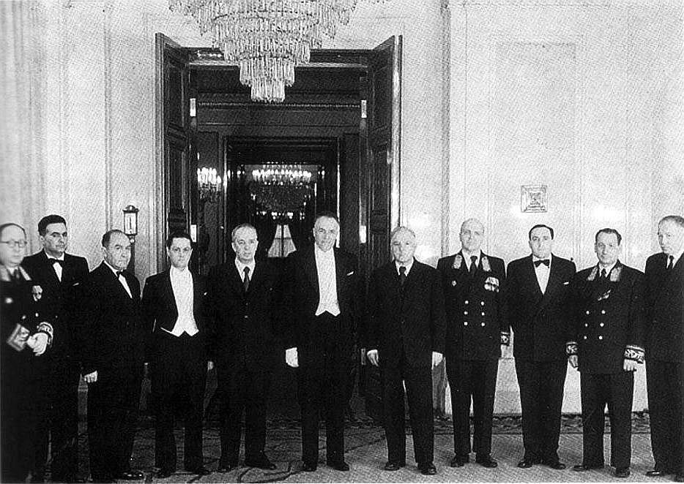
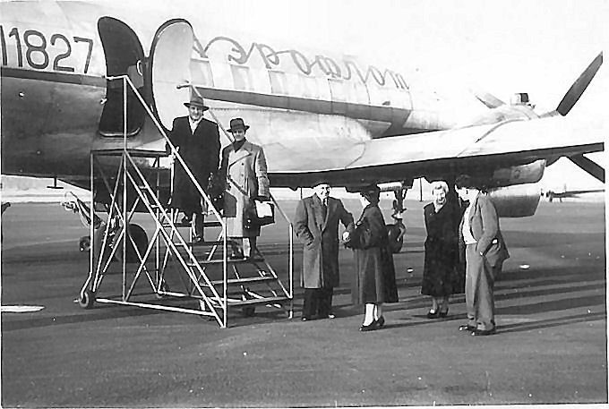
Statesmen…
K. Voroshilov
N. Levanon
Nechemia Levanon
1953 – 1982 – secret service, in the USSR embassy, head of Nativ – responsible for the zionist work with USSR Jews.
1982 - 2003 - kibbutz Kfar Blum

Slide 19
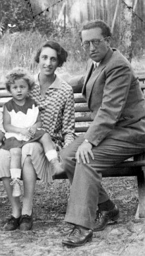
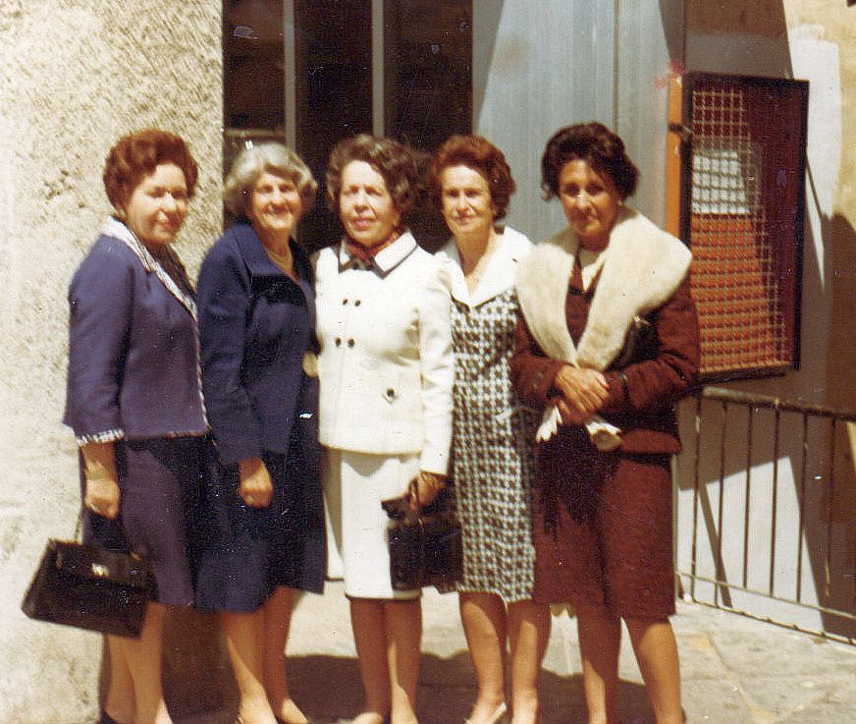
… and the spouses of statesmen
Sima Arlosoroff (Rubin)
(1901-1976)
… and in Israel with Estonian „girls“
In Tallinn in 1929…

Slide 20
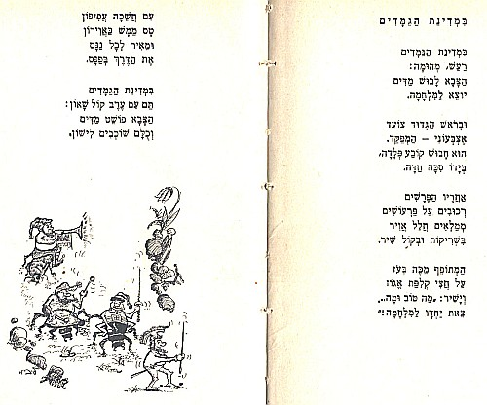
In arts
“In the land of the dwarfs” – one of the most popular children songs was written by …

Slide 21
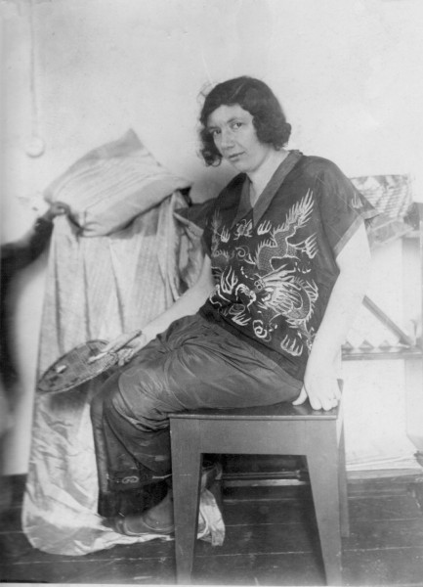
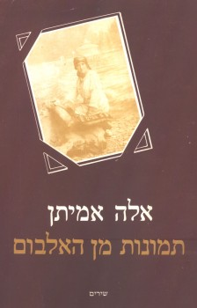
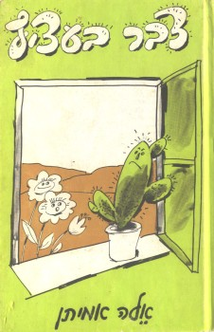
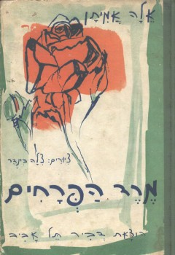
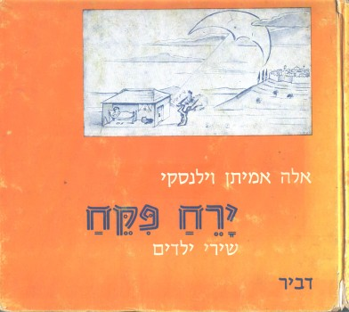
Ella Amitan-Vilensky
(1893 Tartu – 1995 Tel-Aviv)
The first Israeli children poet

Slide 22
In arts
Avi Benjamin (Nedzvetski)
b. 1959
Composer
Pianist
Theater and cinema composer
Musical director of the Gesher theater

Slide 23
Avi Benjamin (Nedzvetski)

Slide 24
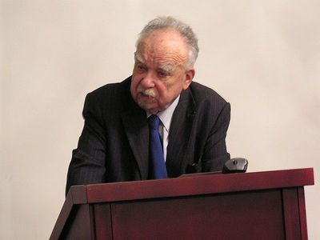
In science
Michael Heltzer
(1928-2010)
Orientalist
Assyrologist
Honorary doctor of Tartu Univ.
Haifa Univ. professor emeritus
Order of the White Star IV grade (2001)

Slide 25
In science
Michael Heltzer
1928 - 2010

Slide 26
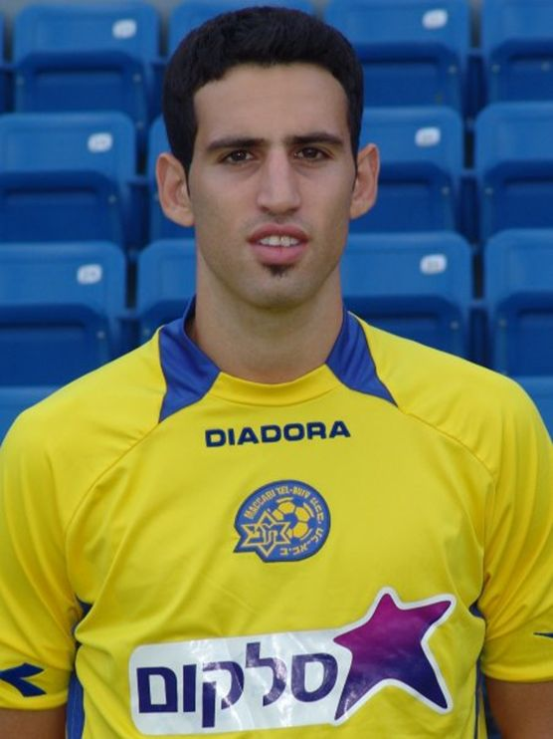
In sport
Yuval Spungin (b. 1987)
Football player
2004-2008 Maccabi Tel-Aviv
Since 2007 in the Israeli national team
2010-2013 AC Omonia, Cyprus

Slide 27
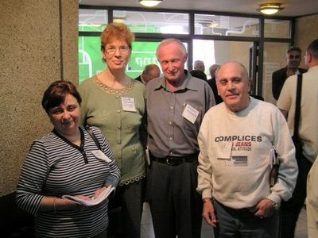
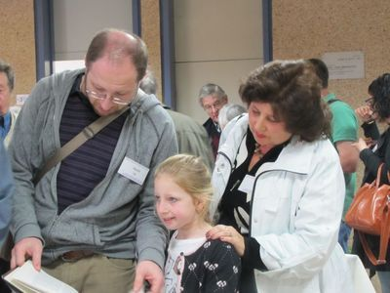
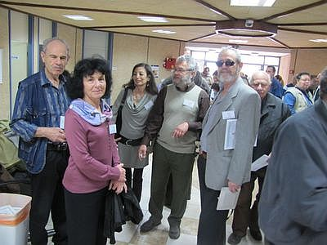
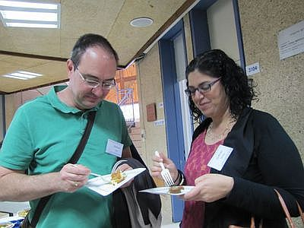
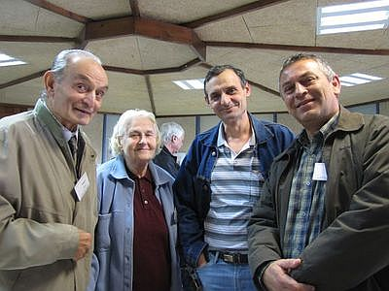
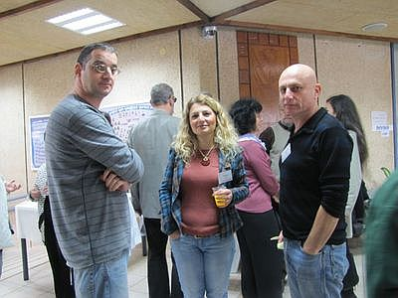
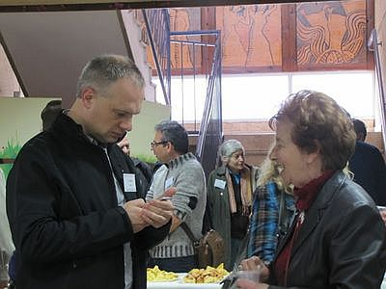
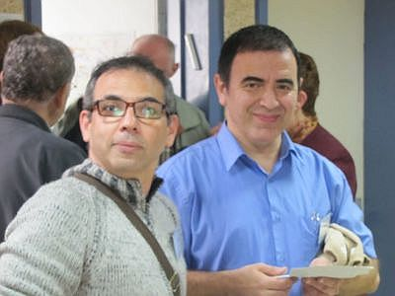
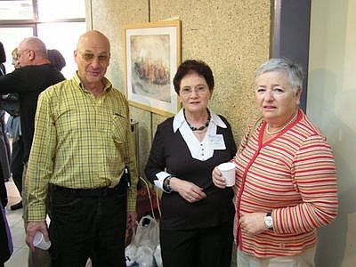
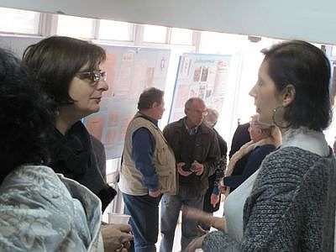
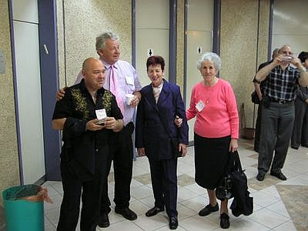
… and in everyday life and work

